Slide 1
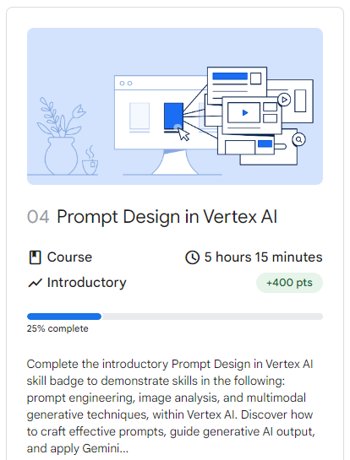



Notes:
https://www.cloudskillsboost.google/paths/118/course_templates/976

Slide 2
Temperature

Slide 3
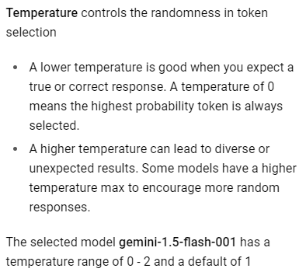
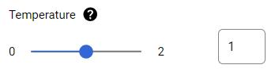
The Most Important Parameter? Probably.
Notes:
https://platform.openai.com/docs/guides/text-generation/faq

Slide 4
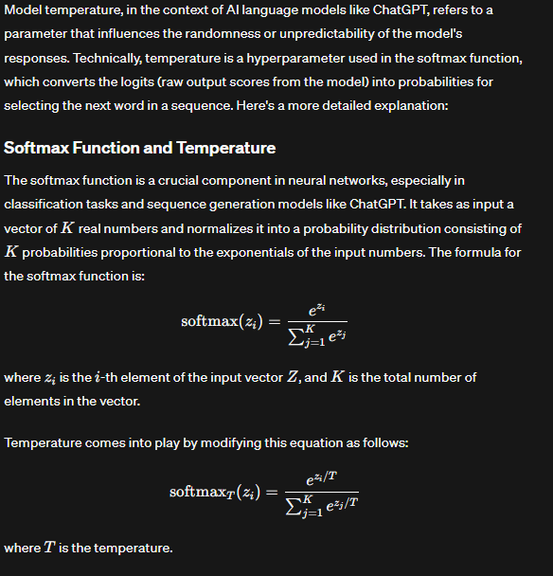
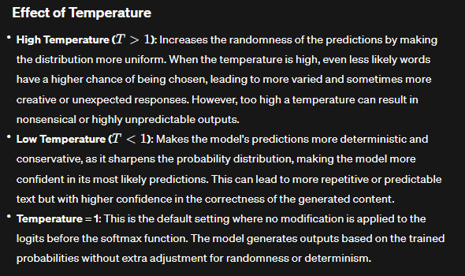
So, What is it Really?

Slide 5
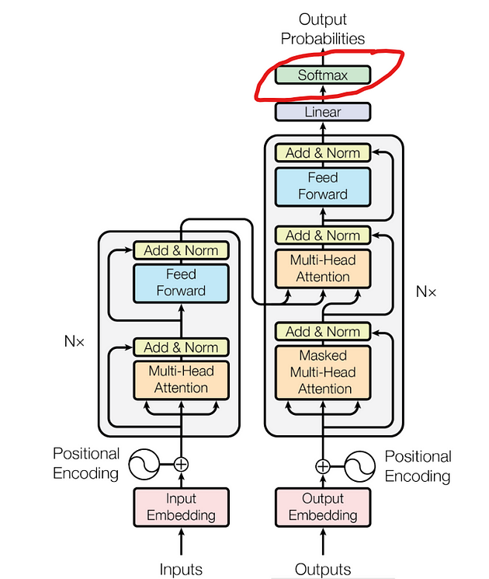
Notes:
https://medium.com/@jpraveenkanna/demystifying-llm-configurations-for-inference-3866979806de

Slide 6
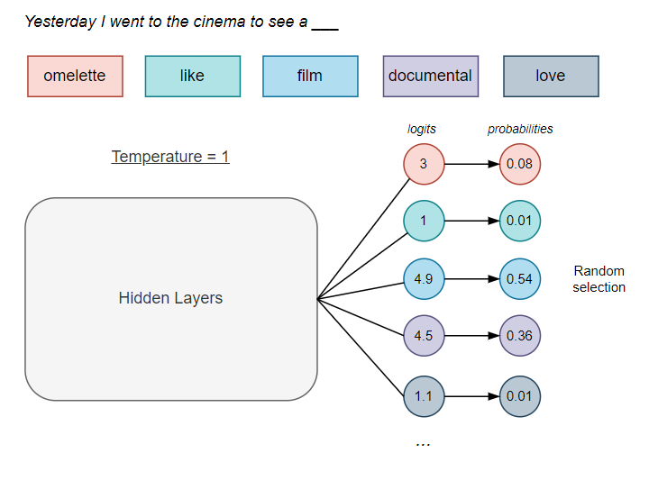
Notes:
https://www.linkedin.com/pulse/science-control-how-temperature-topp-topk-shape-large-puente-viejo-u88yf

Slide 7
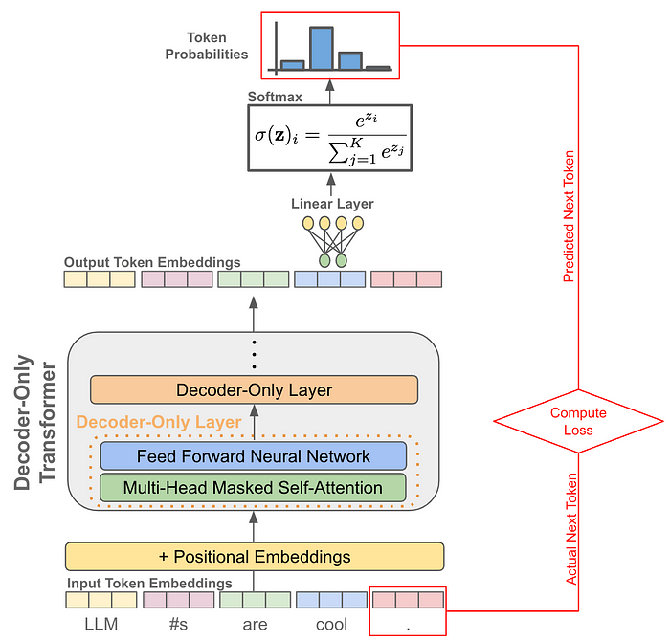

Slide 8
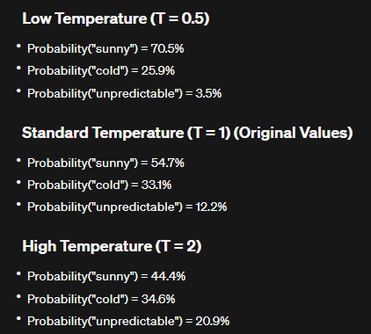
Temperature: SoftMax Probability

Slide 9
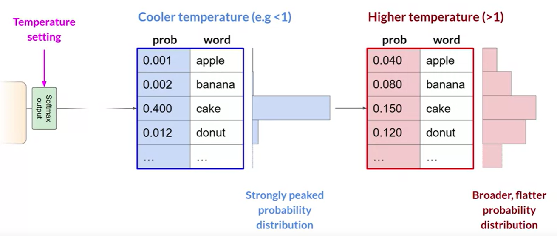
Notes:
https://medium.com/@jpraveenkanna/demystifying-llm-configurations-for-inference-3866979806de

Slide 10
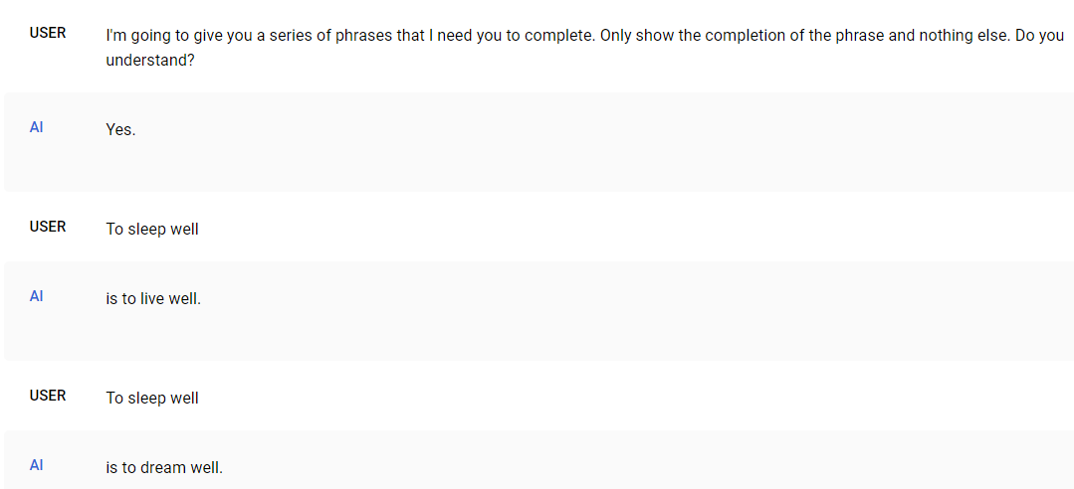
Prediction in Action
Notes:
I'm going to give you a series of phrases that I need you to complete. Only show the completion of the phrase and nothing else. Do you understand?
To sleep well

Slide 11
Output token limit

Slide 12
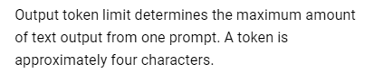
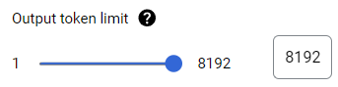

Slide 13
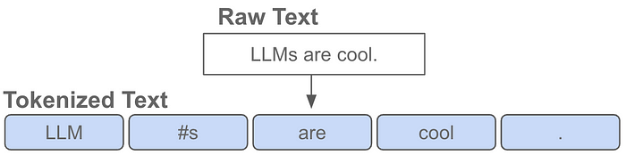
Tokens & Tokenizers
Notes:
https://medium.com/@akash.kesrwani99/understanding-next-token-prediction-concept-to-code-1st-part-7054dabda347

Slide 14

Characters | C | h | a | t | G | P | T
ASCII Values | 67 | 104 | 97 | 116 | 71 | 80 | 84
Binary Values | 01000011 | 01101000 | 01100001 | 01110100 | 01000111 | 01010000 | 01010100
Notes:
No computer understands human language, they just understand ones and zeroes

Slide 15
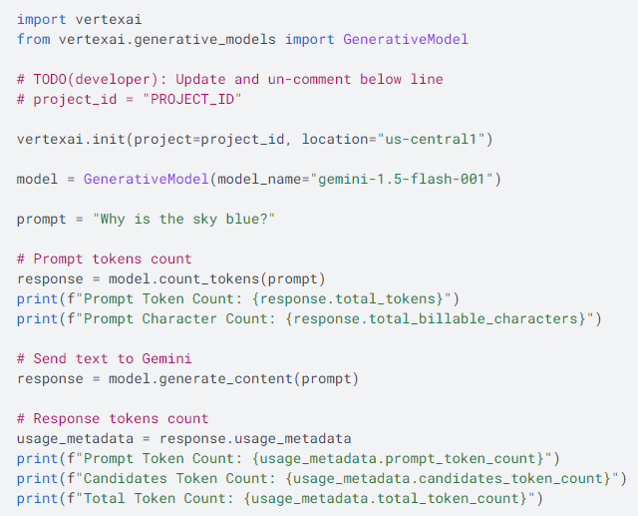
Token counting
Notes:
https://cloud.google.com/vertex-ai/generative-ai/docs/multimodal/get-token-count

Slide 16
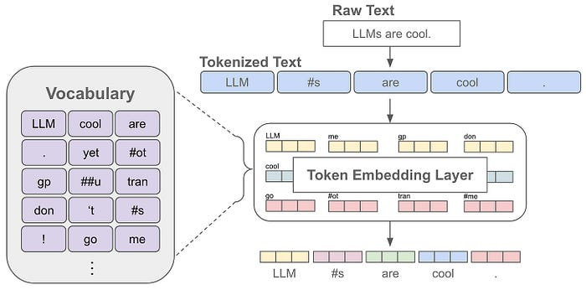
Vocabulary
Notes:
The language model can only understand and generate text using the tokens in its vocabulary. So, the vocabulary contains all the words or sub-words that the language model knows.

Slide 17
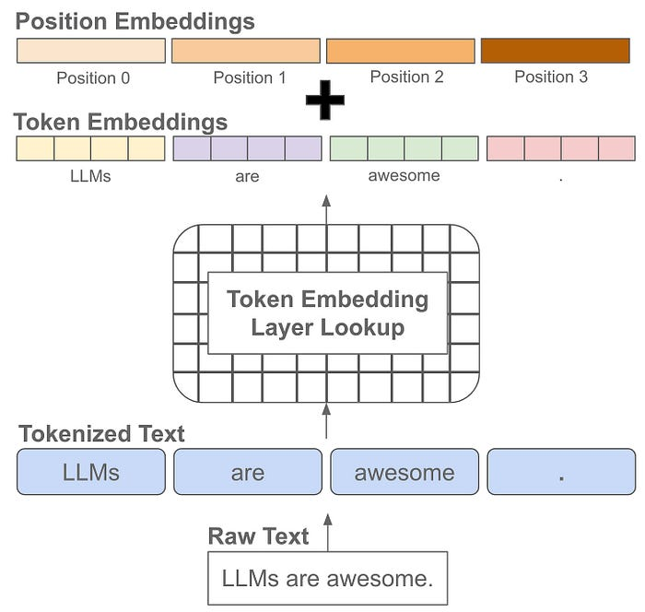
Positioning
Notes:
Positional embeddings are the same size as token embeddings and treated similarly (i.e., they are stored as part of the language model and trained along with other model parameters). Instead of associating an embedding with each unique token, however, we associate an embedding with each unique position that can exist within a tokenized input. Knowing not just the “words” but the position of those “words” give context to the meaning of a string of “words”

Slide 18

Relevant Tokens
Few relevant tokens
Many relevant tokens

Slide 19
Stop Sequence

Slide 20
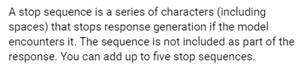
What is a Stop Sequence?

Slide 21
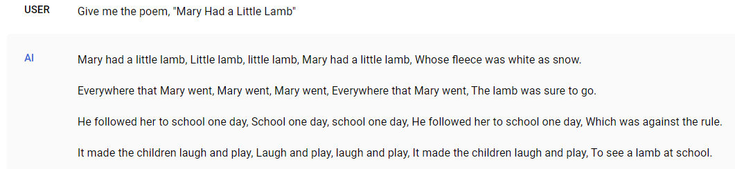
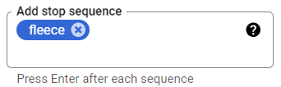
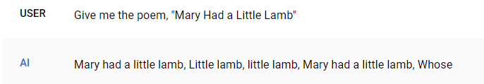
Stop Sequence in Action

Slide 22
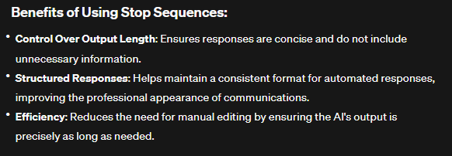
Why Use Stop Sequences?

Slide 23
Safety Settings

Slide 24
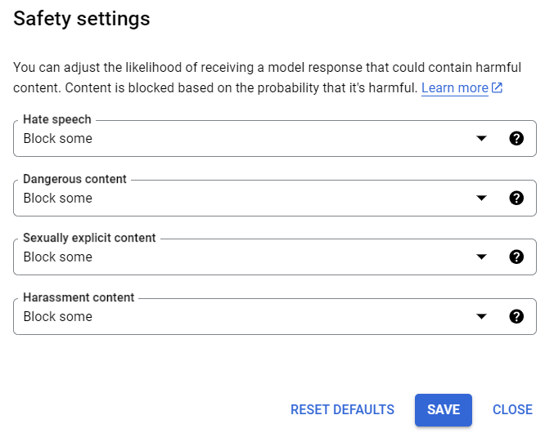

Slide 25
Top_k

Slide 26
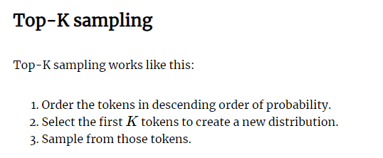
Notes:
https://peterchng.com/blog/2023/05/02/token-selection-strategies-top-k-top-p-and-temperature/

Slide 27
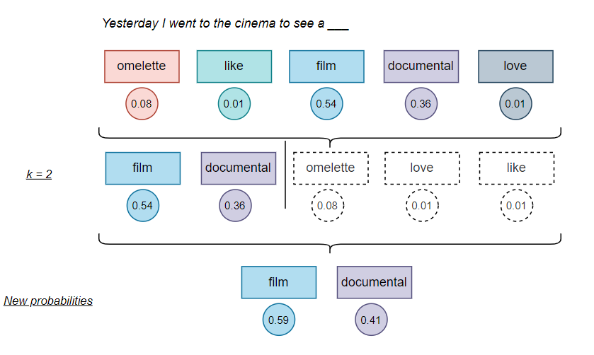
Notes:
https://www.linkedin.com/pulse/science-control-how-temperature-topp-topk-shape-large-puente-viejo-u88yf

Slide 28
Top_p

Slide 29
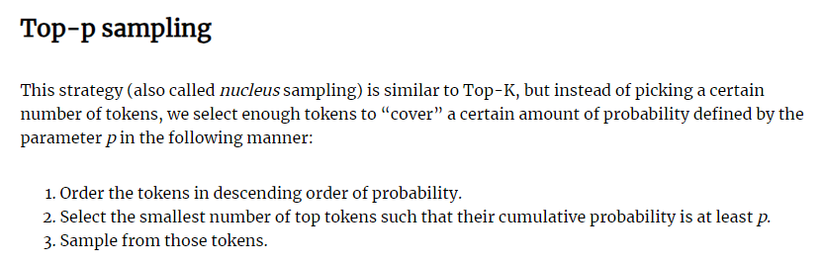
What is Top_p?
Notes:
https://peterchng.com/blog/2023/05/02/token-selection-strategies-top-k-top-p-and-temperature/

Slide 30
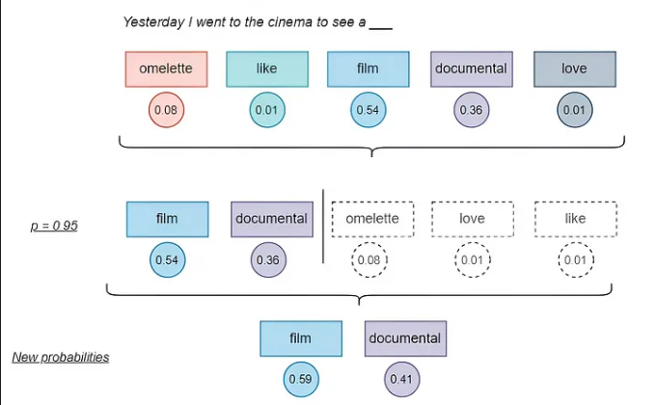
Explaining top_p
Notes:
https://www.linkedin.com/pulse/science-control-how-temperature-topp-topk-shape-large-puente-viejo-u88yf

Slide 31
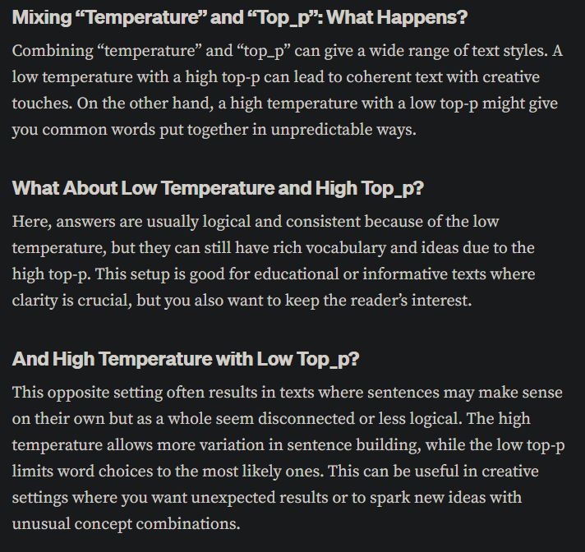
Mixing Temperature with Top_p
Notes:
https://medium.com/@1511425435311/understanding-openais-temperature-and-top-p-parameters-in-language-models-d2066504684f

Slide 32
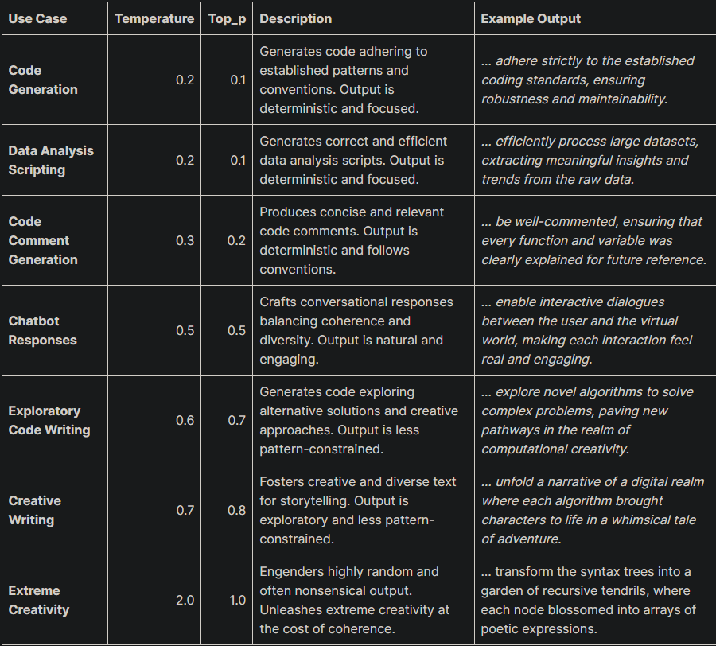
Some Possible Temperature and Top_p Combinations
Notes:
https://web.archive.org/web/20240211144137/https://www.chatgpt-prompts.net/how-to-use-top-p-setting-openai-playground/

Slide 33
Final Thoughts
We made it to the end?

Slide 34
Key Takeaways
Model choice is critical to quality of output as well as cost, you need to strike a balance.
Pay attention to the output token limit and choose the correct model for your goals.
Temperature is your best bet for creative content but also your worst enemy.
Use Top_p and Temperature together to zero in on the output you want.
Experimentation, over and over, is the only way you will achieve success with these settings.

Slide 35


